Slide 1
Providing Insights to the Marketing Team in Food & Beverage Industry CodeX
Ideas for today and tomorrow

Slide 2
Abstract
CodeX is a German beverage company that is aiming to make its mark in the Indian market. A few months ago, they launched their energy drink in 10 cities of India.
Their Marketing team is responsible for increasing brand awareness, market share, and product development. They conducted a survey in those 10 cities and received results from 10k respondents.
Here Our aim is to convert these survey results to meaningful insights which the team can use to drive actions.

Slide 3
Introduction
In this project there are several variables that will have a significant effect on the brand awareness ,market share, and product development.
Marketing channel
Age Group
Gender
Drink Ingredients
Packaging Preferences
Price range etc..

Slide 4
Objective
Determine how the Marketing channel, Age Group ,Gender ,Drink Ingredients ,Packaging Preferences, Price range and purchase location etc.. affect brand awareness ,market share, and product development within the dataset.

Slide 5
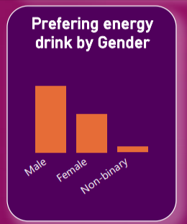
Demographic Insights
Who prefers energy drink more? (male/female/non-binary?)
Analysis: Based on the data presented in the graph, it appears that males are the most frequent consumers of energy drinks, followed by females, and then non-binary individuals. This suggests a gender disparity in energy drink preference, with males being the largest consumer group.

Slide 6
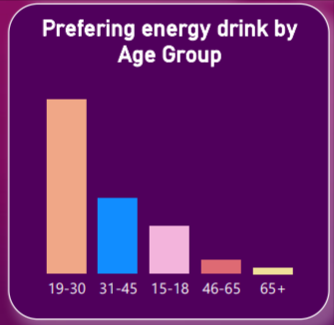
Demographic Insights
Which age group prefers energy drinks more?
Analysis: Graph reveals that the age group between 19 and 30 demonstrates the highest preference for energy drinks. This segment appears to be the most significant consumer group, followed by the age groups of 31-45 and 15-18

Slide 7
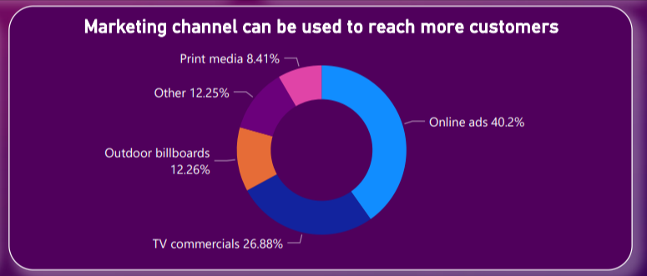
Demographic Insights
Which type of marketing reaches the most Youth (15-30)?
Analysis: Based on the analysis, online advertising would be the most effective type of marketing to reach the most youth (15-30).

Slide 8
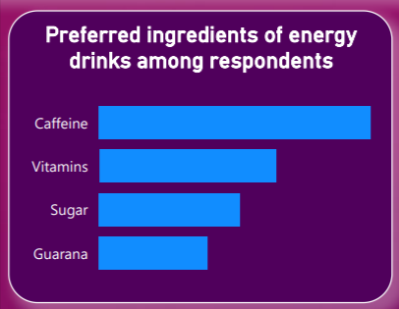
Consumer Preferences
What are the preferred ingredients of energy drinks among respondents?
Analysis: The results indicate that caffeine is the most preferred ingredient, followed by vitamins, and then sugar.

Slide 9
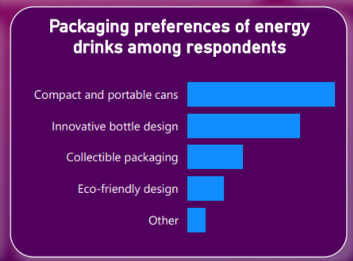
Consumer Preferences
What packaging preferences do respondents have for energy drinks?
Analysis: The respondents overwhelmingly preferred compact and portable cans as their top choice for energy drink packaging.
The second most preferred option was innovative bottle designs, suggesting that consumers appreciate unique and eye-catching packaging

Slide 10
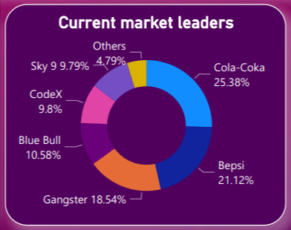
Competition Analysis
Who are the current market leaders?
Analysis: The results suggests that Cola-Coka holds the highest market share and consumer preference among the mentioned energy drink brands, followed by Bepsi and Gangster. The ranking of these brands indicates their relative popularity in the market.

Slide 11
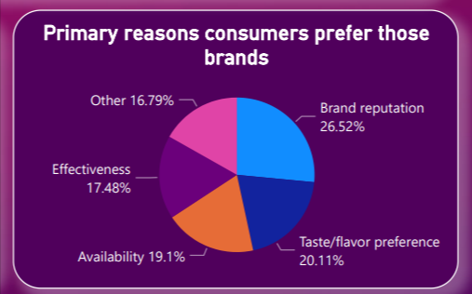
Competition Analysis
What are the primary reasons consumers prefer those brands over ours?
Analysis: In analyzing the graph, it becomes evident that brand reputation emerges as the primary factor influencing consumer preference. This indicates that consumers value and trust established brands more than ours. Additionally, taste/flavor preference and availability are also crucial factors contributing to consumers' brand preferences.

Slide 12
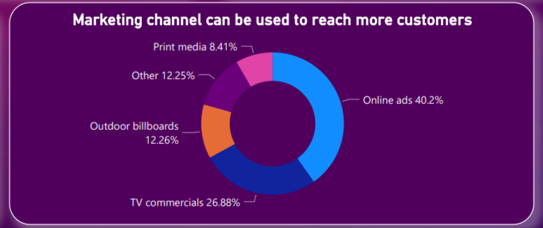
Marketing Channels and Brand Awareness
Which marketing channel can be used to reach more customers?
Analysis: . This suggests that businesses prioritize online advertising as an effective means of reaching a wider audience, while still recognizing the value of television and outdoor advertising in their marketing strategies.

Slide 13
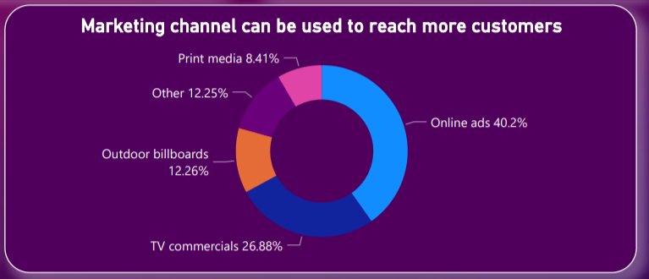
Marketing Channels and Brand Awareness
How effective are different marketing strategies and channels in reaching our customers?
Analysis : Based on the analysis, online advertising is highlighted as an effective means of reaching a wider audience, while television and outdoor advertising are still recognized as valuable marketing channels.

Slide 14
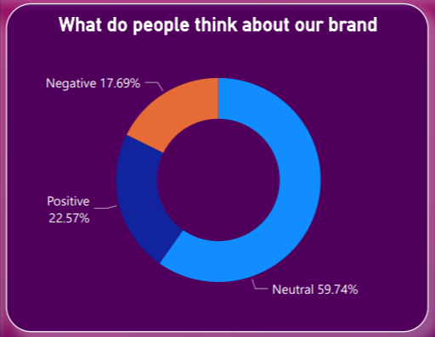
Brand Penetration
What do people think about our brand? (overall rating)
Analysis: Based on the graph, the overall rating of our brand indicates a mixed sentiment among people. While a significant portion of individuals hold a neutral view, there is also a positive sentiment among some respondents.

Slide 15
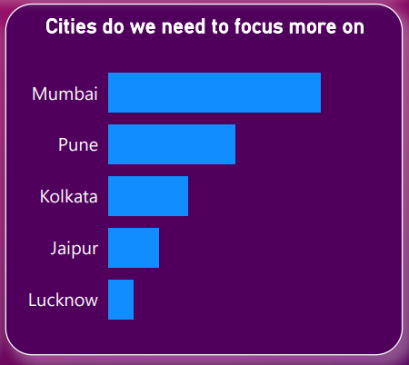
Brand Penetration
Which cities do we need to focus more on?
Analysis: Based on the graph data, the top 5 cities to focus on for the Marketing Team in the Food & Beverage Industry are Mumbai, Pune, Kolkata, Jaipur, and Lucknow.

Slide 16
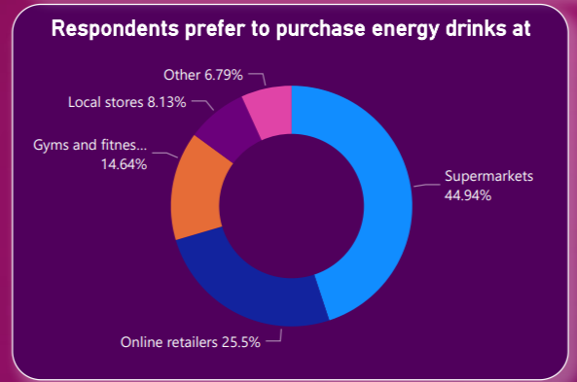
Purchase Behavior
Where do respondents prefer to purchase energy drinks?
Analysis: The majority of respondents indicated a preference for purchasing energy drinks at supermarkets, followed by retailers, gyms and fitness centers, and finally local stores.

Slide 17
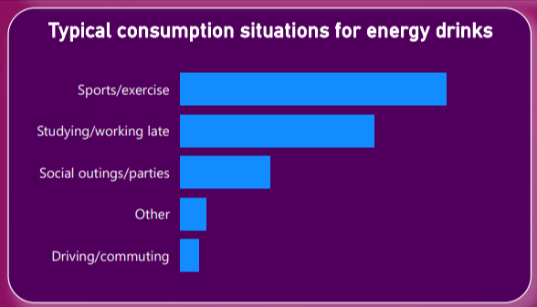
Purchase Behavior
What are the typical consumption situations for energy drinks among respondents?
Analysis: The most typical consumption situations for energy drinks among respondents are sports/exercise, studying/working late, and social outings/parties.

Slide 18
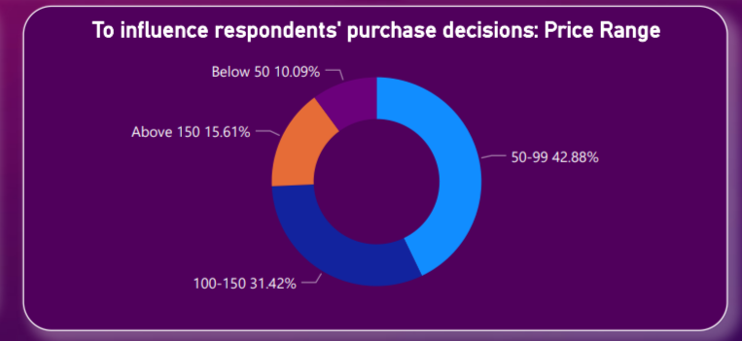
Purchase Behavior
What should be the ideal price of our product?
Analysis : Based on the analysis of the price preferences indicated in the graph, it is evident that most people prefer energy drinks within the price range of 50-99 rupees, followed by the range of 100-150 rupees, and a smaller portion is willing to pay above 150 rupees.

Slide 19
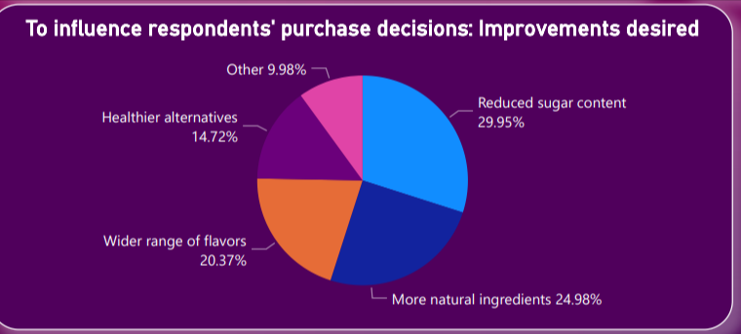
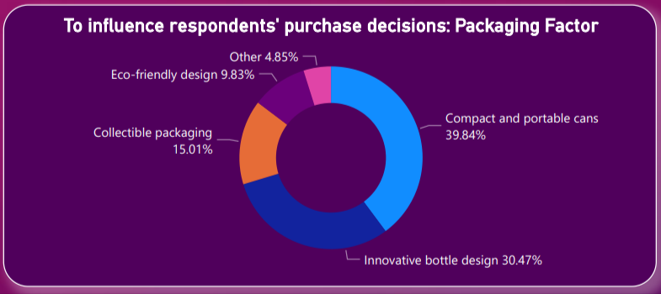
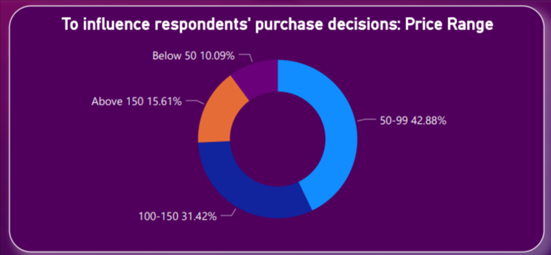
Purchase Behavior
What factors influence respondents' purchase decisions, such as price range and limited edition packaging?

Slide 20
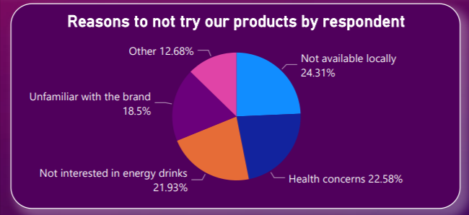
Product Development
Which area of business should we focus more on our product development? (Branding/taste/availability)
Analysis: Based on the analysis provided, the area of business that should be focused on for product development is availability. By increasing accessibility, the brand can overcome health concerns, lack of interest in energy drinks, and unfamiliarity with the brand.

Slide 21
Conclusion
- Males are the largest consumers of energy drinks, followed by females and non-binary individuals.
- The age group of 19-30 shows the highest preference for energy drinks, followed by 31-45 and 15-18.
- Compact cans are the preferred packaging option, followed by innovative bottle designs.
- Cola-Coka is the most popular energy drink brand, followed by Bepsi and Gangster.
- Brand reputation, taste/flavor, and availability influence consumer preference.
- Online advertising is effective, but television and outdoor advertising are still relevant.
- The brand's rating shows a mix of positive and neutral sentiment.
- Key cities for marketing in the Food & Beverage Industry are Mumbai, Pune, Kolkata, Jaipur, and Lucknow.
- Supermarkets are the preferred purchase location, followed by retailers, gyms, and local stores.
- Common consumption situations for energy drinks are sports/exercise, studying/working late, and social outings/parties.

Slide 22
Recommendation
What immediate improvements can we bring to the product?
Based on the analysis, it would be beneficial to consider introducing more innovative bottle designs alongside the existing compact and portable cans. This can cater to consumer preferences for unique and eye-catching packaging.

Slide 23
Recommendation
What should be the ideal price of our product?
Based on the analysis, the ideal price of the energy drink should be within the range of 50-99 rupees.

Slide 24
Recommendation
What kind of marketing campaigns, offers, and discounts we can run?
To effectively market the product, it would be advantageous to focus on highlighting the brand's reputation, taste/flavor preferences, and availability. Running targeted online advertising campaigns would reach a wider audience, while incorporating television and outdoor advertising to complement the overall marketing strategy. Offers and discounts, such as bundle deals or limited-time promotions, can help drive consumer interest and increase sale

Slide 25
Recommendation
Who can be a brand ambassador, and why?
An ideal brand ambassador could be an influential figure from the sports or fitness industry, given the popularity of energy drinks among individuals engaged in physical activities.

Slide 26
Recommendation
Who should be our target audience, and why?
Based on the analysis, the target audience should primarily focus on males, particularly those within the age group of 19-30. This group demonstrated the highest preference for energy drinks and is likely to be receptive to marketing efforts. However, it is also important to consider the secondary audience, such as females and individuals aged 31-45 and 15-18, to ensure a broader market reach and potential growth opportunities.

